Slide 1
IS457 Mobile Applications
Lecture 3
Mobile Programming- Android Studio

Slide 2
Android Studio
Java Eclipse was the programming language to build applications.
In May 2013, it was announced at the Google I/O conference of 2013 that Google had bought Android Studio.
Android Studio is the official IDE and specialized for Android application development.

Slide 3
Framework Capabilities and Add-Ons
Tailored to mobile apps
Built-in services:
GUI, OS services (file I/O, threads, device management), Graphics, Device, access (GPS, camera, music and video players, sensors), Web services, Networking, XML processing, Standard language libraries.
Add-ons:
Maps
Database support (SQLite)
WebKit

Slide 4
Android Studio Project Components
Activity: a “single screen” that’s visible to user
Service: long-running background “part” of app.
ContentProvider: manages app data (usually stored in database) and data access for queries.
BroadcastReceiver: component that listens for particular Android system “events”, e.g., “found wireless device”, and responds accordingly.

Slide 5
Android Activity
Application
Android system operation is performed by triggering an Activity.
Single, focused thing that the developer can do to create a screen that the users can interact with.
Activity
Activity
Activity
View
View
View

Slide 6
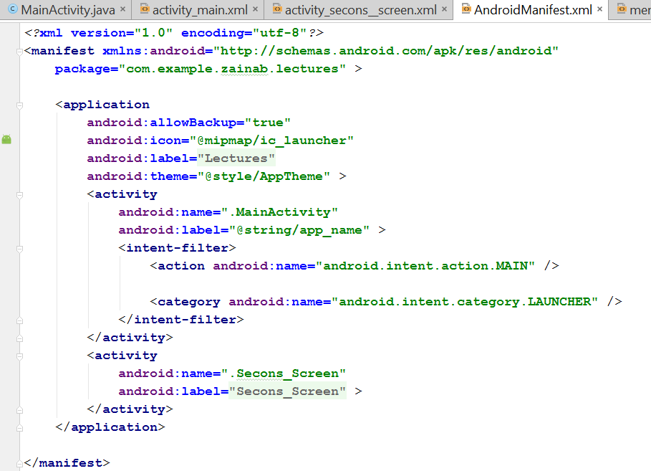
Android Manifest
Every app must have AndroidManifest.xml
The manifest file provides essential information about your app to the Android system, which the system must have before it can run any of the app's code.

Slide 7
Android Manifest
The manifest specifies:
App’s Activities, Services, etc.
Permissions requested by app
Minimum API required
External libraries to which app is linked, e.g., Google Maps library.

